Slide 1

MACHINE LEARNING-BASED THREE-YEAR PREDICTION OF CARDIOVASCULAR DISEASE AND MAJOR EVENTS IN PATIENTS WITH NO PRIOR HISTORY
SQF 7027 – Project Presentation
Supervisor - Dr. Sorayya Malek
Malithi De Silva
22058205

Slide 2
Contents
BACKGROUND OF STUDY
METHODOLOGY
RESULTS & DISCUSSION
CONCLUSION

Slide 3

01
Background of Study

Slide 4
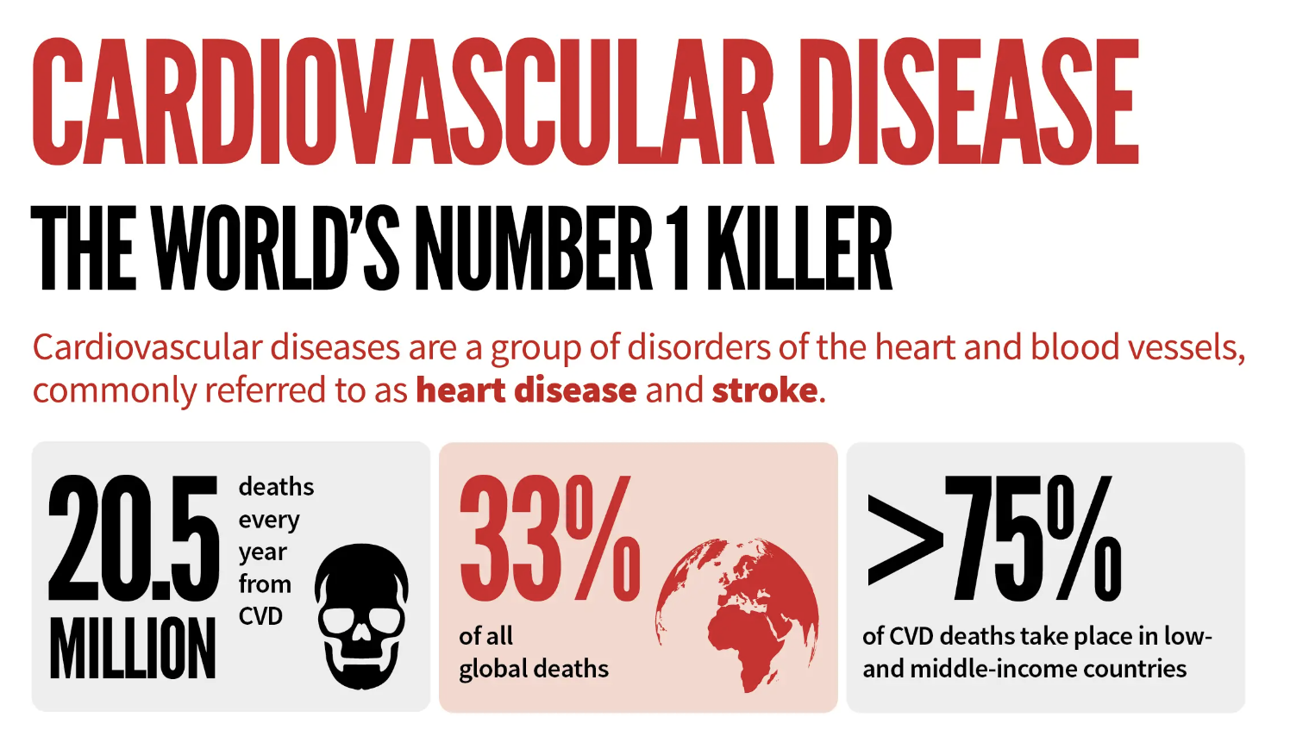
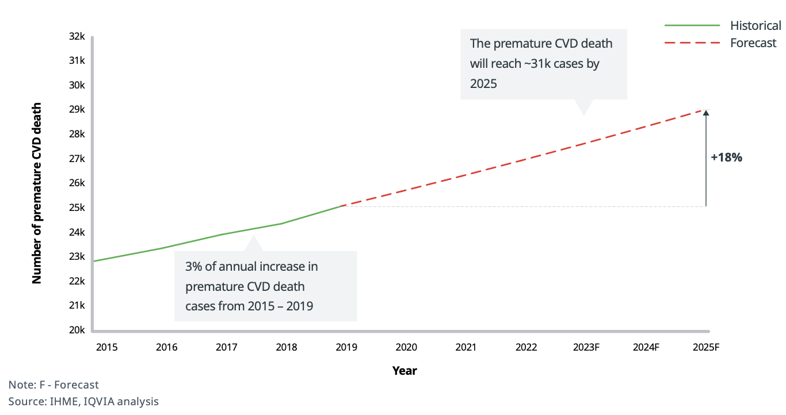
CARDIOVASCULAR DISEASE
CVD has been the leading cause of death in Malaysia since the 1980s.
Sourced from: WHO (2021); World Heart Federation.
Sourced from: IHME, IQVIA analysis, (2023)
Notes:
Slide 1: CVD Global and Malaysian Statistics/Epidemiology
Global Statistics:
Non-communicable diseases (NCDs) account for 74% of global deaths (41 million) in 2019 (WHO, 2023).
Cardiovascular disease (CVD) is responsible for 44% of all NCD-related deaths, equating to approximately 17.9 million deaths (WHO, 2021, 2023).
Malaysian Statistics:
CVD has been the leading cause of death in Malaysia since the 1980s (IPH, 2020).
Ischemic heart disease (IHD) was the principal cause of death from 2001 to 2020.
In 2021, IHD accounted for 13.7% of 157,251 medically certified deaths, with deaths increasing from 18,526 in 2020 to 21,485 in 2021 (DOSM, 2022).
Economic and Social Impact in Malaysia:
In 2017, CVDs caused 1,397,311 Disability-Adjusted Life Years (DALYs) in Malaysia, resulting in an economic loss of around RM59.85 billion (MOH, 2020).
IHD and stroke contributed to RM32.48 billion and RM18.28 billion of economic loss, respectively.
Image Suggestions:
Global NCD mortality chart.
Malaysian CVD statistics graph.

Slide 5
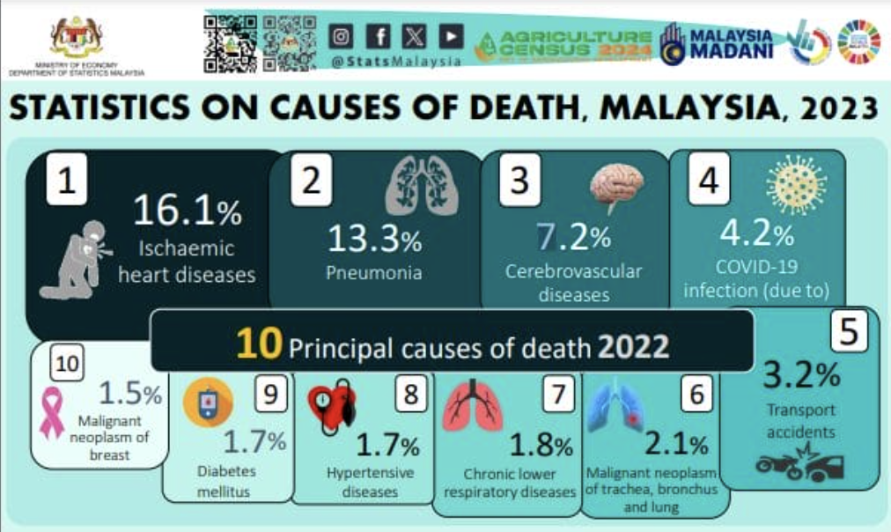
In Malaysia, IHD, which includes MyocardiaI Infarction, remains the leading cause of death.
Cerebrovascular diseases including strokes are the 3rd leading cause of death
MI, & Stroke are major contributors to the overall CVD burden
In 2017, CVDs caused 1,397,311 Disability-Adjusted Life Years (DALYs) in Malaysia, resulting in an economic loss of around RM 59.85 billion.
Sourced from: DOSM, (2023)
Sourced from: MOH, (2020); IPH, (2020)
Sourced from: Hwang et al. (2022); DOSM, (2022)
Notes:
Slide 2: Focus on MI, Stroke, and Heart Failure
Myocardial Infarction (MI):
Occurs when blood flow to the heart is blocked, leading to heart muscle damage.
Major cause of morbidity and mortality globally and in Malaysia.
In Malaysia, IHD, which includes MI, remains a leading cause of death.
Stroke:
Occurs when blood supply to part of the brain is interrupted, causing brain damage.
Incidence of stroke is rising in Malaysia, with deaths increasing from 9,105 in 2020 to 10,181 in 2021 (DOSM, 2022).
Heart Failure (HF):
A condition where the heart is unable to pump blood effectively, often resulting from various CVDs.
Seen as the final stage of many CVDs, significantly impacting health and quality of life.
Importance of these CVD Events:
MI, stroke, and HF are major contributors to the overall CVD burden.
Effective prediction and prevention can significantly reduce morbidity and mortality.
Image Suggestions:
Visuals illustrating the impact of MI, stroke, and HF.
Statistical charts showing the incidence and mortality rates of these conditions in Malaysia.

Slide 6
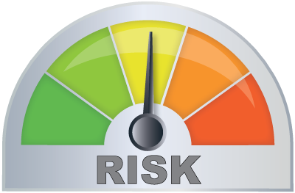
CVD RISK SCORES
CVD risk scores are tools used to estimate an individual's likelihood of experiencing a cardiovascular event, such as a heart attack or stroke, within a specific time frame (10 years). These scores are calculated based on various risk factors
Existing CVD Risk Scores
Issues?
Developed based on non-Malaysian populations, often resulting in poor calibration for Malaysian demographics.
(Chia et al., 2015; Selvarajah et al., 2014)
Revised Pooled Cohort Equation (RPCE)
Framingham Risk Score (FRS)
Existing models typically provide 10-year risk predictions, which may not effectively capture short/ medium-term risks. (Gore et al., 2020; Quispe et al., 2015)
Systematic Coronary Risk Evaluation 2 (SCORE2)
Notes:
Risk score, FRS – issues, not for Malaysia demographics, only for 10 years lit review for ML that works for 10 years, also for MI stroke classification gap? Problem statement research objectives, Shap conclusion

Slide 7
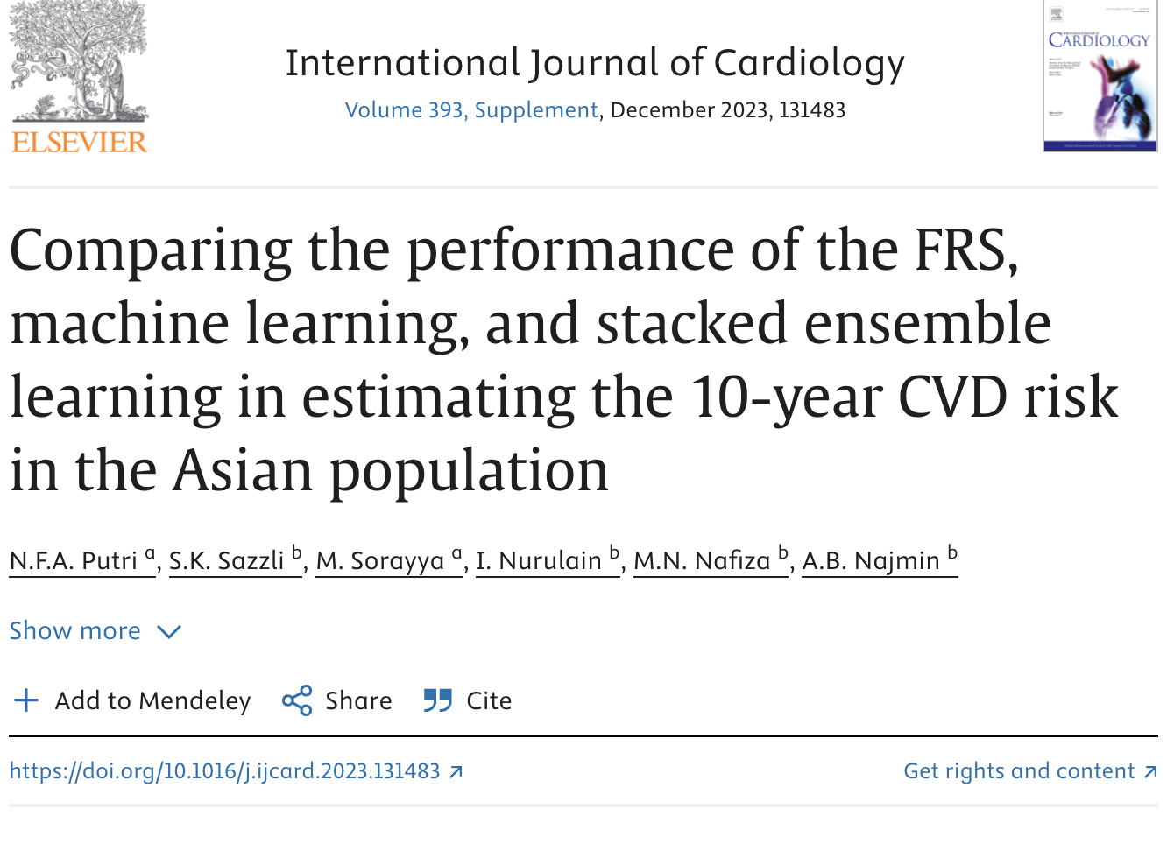
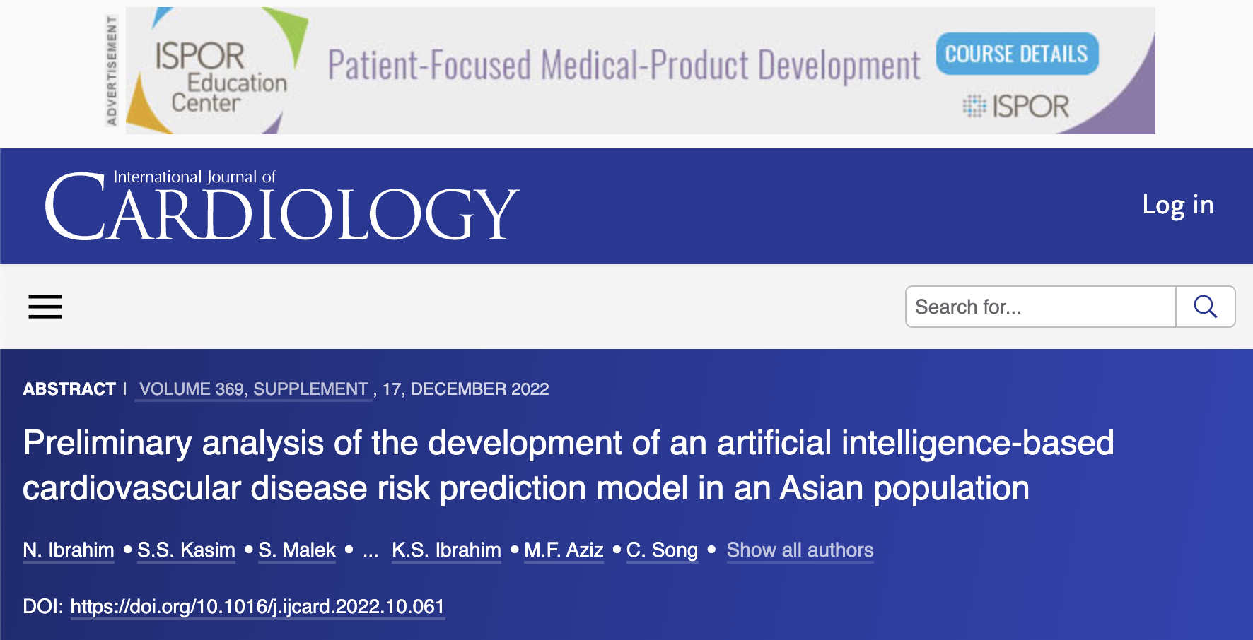
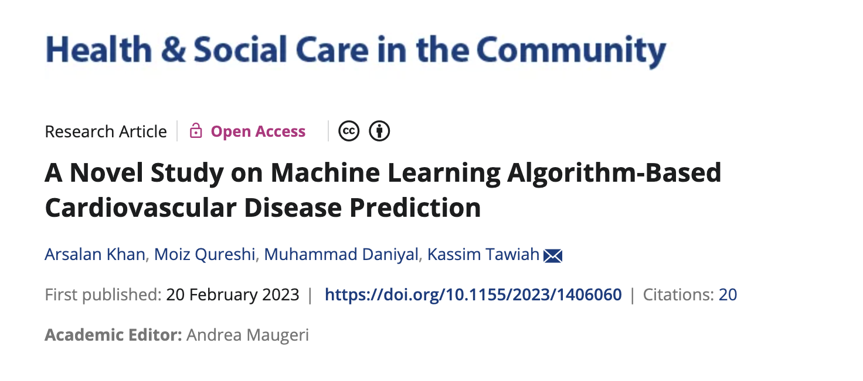
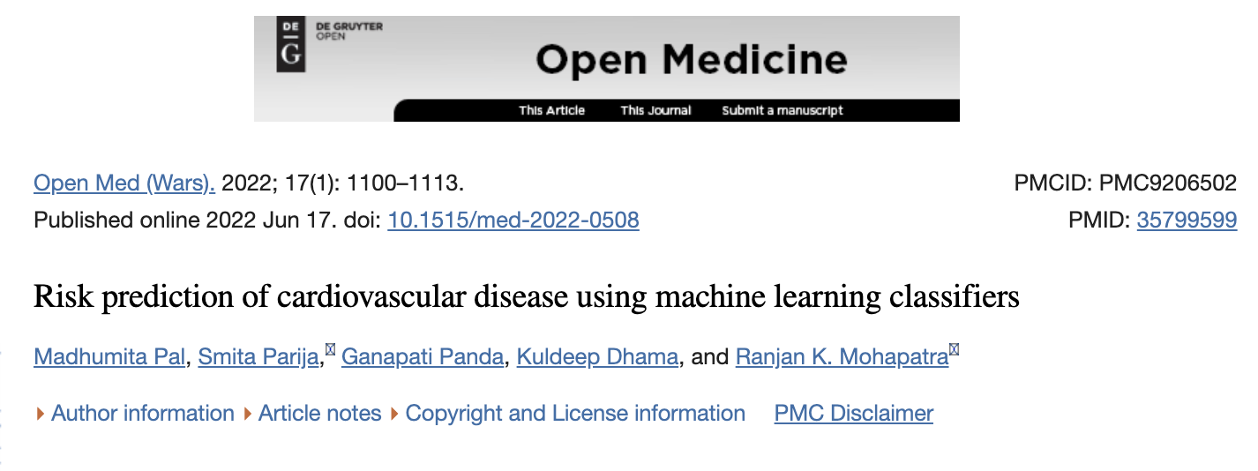
Solution → Machine Learning
Why Machine Learning? Why a Three-Year Prediction model?
Research Gap = No studies that focus on ML based 3-year prediction models for CVD, specifically for myocardial infarction (MI) and stroke events in the Malaysian population.
Sourced from: Putri et al., (2023); Khan et al., (2023); Ibrahim et al., (2022); Pal et al., (2022)
Notes:
Slide 3: Limitations of Conventional Risk Scores and the Need for a Three-Year Model
Conventional Risk Scores:
Framingham Risk Score (FRS), Pooled Cohort Equations (PCE), SCORE2:
Developed based on non-Malaysian populations, often resulting in poor calibration for Malaysian demographics (Chia et al., 2015; Selvarajah et al., 2014).
Validation studies in Malaysia show varying predictive accuracies (AUC values of 0.63 and 0.76 for FRS).
Why Conventional Scores are Not Suitable:
Overestimate or underestimate CVD risk in the Malaysian population due to different lifestyle and genetic factors (Kasim et al., 2023).
Need for ongoing validation and customization to fit the multiethnic Malaysian population.
Why a Three-Year Prediction Model is Needed:
Existing models typically provide 10-year risk predictions, which may not effectively capture short-term risks.
Short-term prediction models enable timely intervention and more aggressive preventive measures, crucial for reducing immediate CVD events (BMC Cardiovascular Disorders).
Studies have highlighted the effectiveness of short-term risk assessment in improving patient outcomes (Neural Computing and Applications).
Image Suggestions:
Flowchart comparing traditional and ML-based prediction models.
Visual representation of short-term (three-year) vs. long-term (ten-year) prediction models.

Slide 8
PROBLEM STATEMENT
AIM
Limitations of Conventional Risk Scores:
- FRS lacks population specificity for the Malaysian multi-ethnic population.
- Inadequate for accurate short-term CVD predictions.
Need for Short-Term Prediction:
- Rapid CVD progression in some patients necessitates shorter prediction windows for early intervention.
Research Gap:
- Few studies focus on ML-based risk prediction models specifically for CVD events like, myocardial infarction (MI), and stroke.
To develop three-year ML-based risk prediction models for CVD, MI, and stroke for the Malaysian demographic

Slide 9

RESEARCH QUESTIONS
What are the key predictors for accurate CVD risk models?
How does a 3-year CVD risk model for the Malaysian population compare to the Framingham Risk Score (FRS)?
Can a machine learning model accurately classify MI and stroke within 3 years in the Malaysian population?
What are the key predictors for accurate CVD risk models?

Slide 10

OBJECTIVES
To identify key predictors of CVD risk.
To develop a general 3-year CVD risk model for the Malaysian population.
To develop a model for classifying MI and stroke within 3 years.
To compare the performance of the general CVD risk model with conventional FRS risk scores

Slide 11
02
Methodology

Slide 12




Methodology - Study Data
REDISCOVER DATASET (Responding to Increasing Cardiovascular Disease Prevalence)
An observational longitudinal community-based study
Total Features: 53 features Categories of Features:
Demographic
Clinical
Lifestyle
Family History
Respiratory
12,617 participants aged 18 and up, across Eight different states
Represents Malaysia's major ethnic groups
2007 – On Going

Slide 13
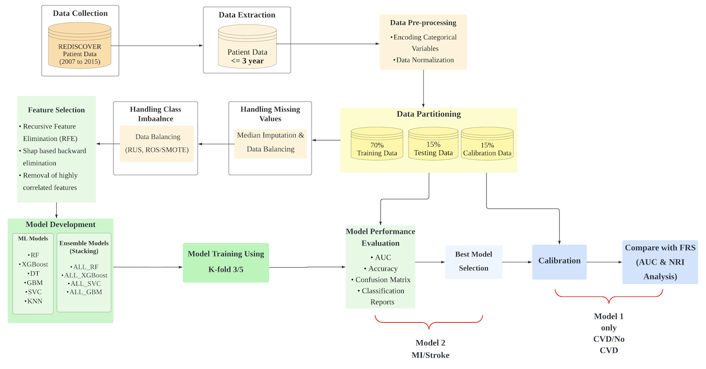
Framework

Slide 14
03
Results & Discussion

Slide 15
Feature Comparison - Model 1
FRS (7) | Shap based BE (26 features) |  | RFE (10 features)
1. Sex | 1. Area | 14. Diabetes | 1. Area
2. Age | 2. Systolic BP | 15. Heartdisease | 2. Age
3. Total cholesterol or LDL | 3. Age | 16. Height | 3. Systolic BP
4. HDL | 4. Waist Hip Ratio | 17. Hpt_f | 4. Diastolic BP
5. Systolic bp | 5. Hpt_med | 18. Glucose_baseline | 5. Waist
6. Diabetes | 6. Gender | 19. Bmi | 6. Waist Hip Ratio
7. Smoking | 7. FVC | 20. Handgrip_nondominant | 7. Glucose baseline
 | 8. HDL | 21. Smoking | 8. TG baseline
 | 9. Hpt_b | 22. Rightcalf | 9. HDL
 | 10. Waist | 23. Head | 10. Forced Expiratory Volume in 1 Second
 | 11. TG_baseline | 24. Rightarm
 | 12. Diastolic BP | 25. Diabetes_f
 | 13. Diastolic BP | 26. Ldl_baseline
Common predictors of all ML models with FRS score:
Age
HDL
Systolic BP

Slide 16
Model 1 (CVD/No CVD)
Model (best) | Feature extraction (feature numbers) | Test |  |  |  | AUC diff
 |  | AUC | Accuracy | Sensitivity | Specificity
XGBoost | None (48) | 0.828 | 0.792 | 0.666 | 0.794 | 0.040
RF | RFE (10) | 0.828 | 0.760 | 0.761 | 0.760 | 0.025
RF | Shap based BE (26) | 0.858 | 0.810 | 0.761 | 0.811 | 0.024
SVC | Shap based BE (26) | 0.766 | 0.822 | 0.666 | 0.767 | 0.026
GBM | Shap based BE (26) | 0.820 | 0.770 | 0.666 | 0.771 | 0.038
ALL_SVC | Shap based BE (26) | 0.820 | 0.772 | 0.857 | 0.771 | 0.179
ALL_GBM | Shap based BE (26) | 0.817 | 0.767 | 0.761 | 0.767 | 0.182
The RF models give better or comparable performance (AUC 0.858 & 0.828) compared to the FRS risk score (AUC = 0.834)
The best model for predicting is the RF model with 26 selected features (AUC = 0.858)

Slide 17
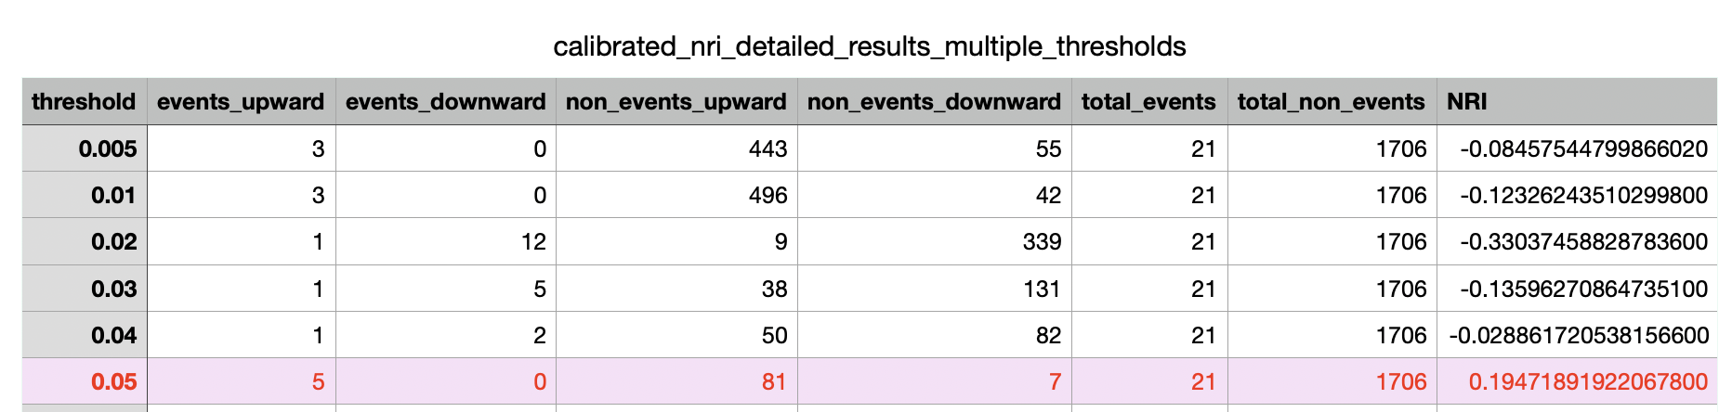
Net Reclassification Improvement (NRI) Index
NRI for best RF model vs FRS
Purpose of NRI: Compares how well two models (FRS vs. ML) distinguish between low- and high-risk individuals.
Optimal Threshold: 0.05 with NRI of +0.194, indicating the best reclassification improvement. (19% improvement of RF model)

Slide 18
Model 2 (MI/Stroke)
Model (best) | Feature extraction (feature numbers) | Test |  |  |  | AUC diff
 |  | AUC | Accuracy | Sensitivity | Specificity
RF | None | 0.759 | 0.666 | 0.555 | 0.636 | -0.048
SVC | None | 0.716 | 0.611 | 0.555 | 0.777 | -0.046
ALL_RF | RFE-RF | 0.691 | 0.611 | 0.777 | 0.444 | -0.004
RF | RFE-LR | 0.728 | 0.722 | 0.777 | 0.666 | -0.039
DT | RFE-RF | 0.722 | 0.722 | 0.555 | 0.888 | -0.051
ALL_SVC | Shap based BE (14) | 0.925 | 0.833 | 0.666 | 0.888 | -0.006
ALL_RF | Shap based BE (14) | 0.944 | 0.833 | 0.777 | 0.888 | 0.020
ALL_GBM | Shap based BE (14) | 0.870 | 0.888 | 0.777 | 1.000 | 0.010
Most Ensemble models give better performance than the single models.
RF Ensemble was the best model with a very high performance (AUC = 0.944) and good classification between MI and Stroke classes

Slide 19
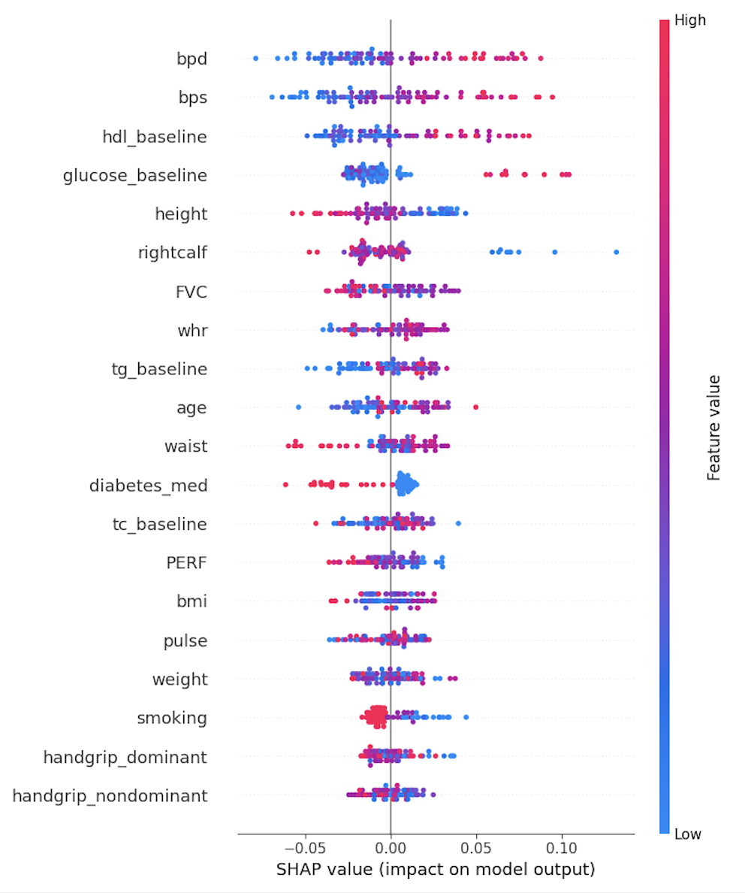
Feature Interpretability (SHAP)
Positive Impact:
Higher Systolic and Diastolic BP values increase the likelihood of predicting myocardial infarction (MI).
Negative Impact:
Lower values of FVC, Diabetes Medication use, and PERF increase the likelihood of predicting MI and decrease the likelihood of predicting stroke.
Less Influential Features:
Handgrip strength, weight, and smoking have minimal influence on distinguishing between MI and stroke in the model.
Shap based BE (14 features)
1. Diastolic BP
2. Systolic BP
3. HDL
4. Glucose_baseline
5. Height
6. Rightcalf
7. FVC
8. Waist Hip Ratio
9. Tg_baseline
10. Age
11. Waist
12. Diabetes_med
13. Tc_baseline
14. PERF

Slide 20
04
Conclusion

Slide 21


Conclusions
The 3-year general model for CVD/ No CVD for Malaysians demonstrated better performance than the conventional risk scoring method (FRS) that was derived from the Western population at a certain threshold level.
The second model, designed to classify myocardial infarction (MI) and stroke events for 3 years, showed strong predictive performance.

Slide 22
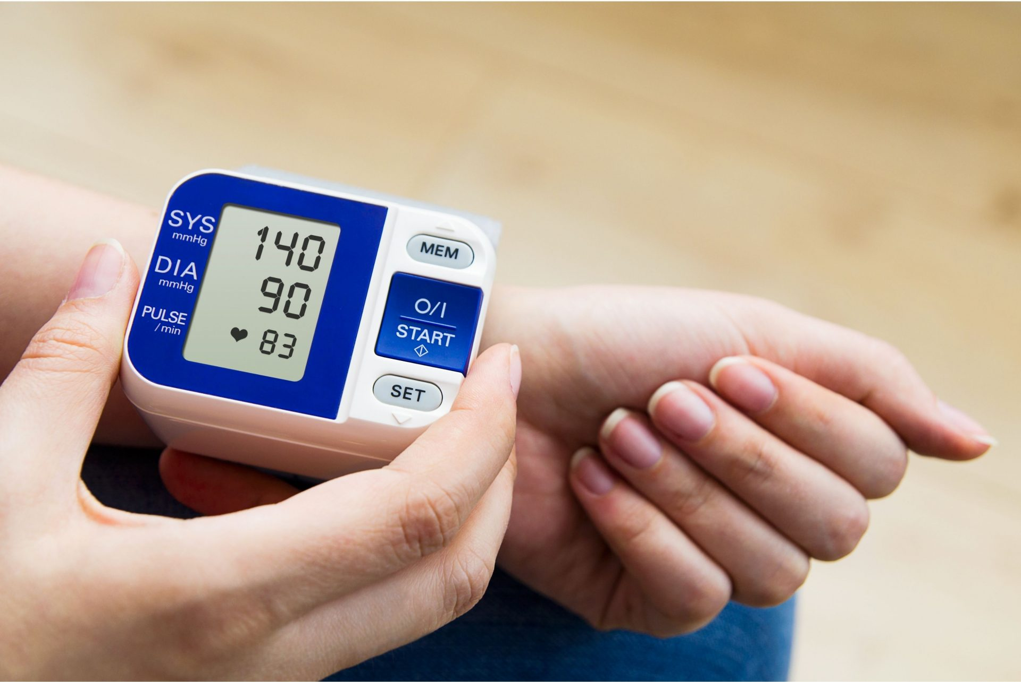
THANK YOU!

Slide 23
REFERENCES
Chia, Y. C., Gray, S. Y. W., Ching, S. M., Lim, H. M., & Chinna, K. (2015). Validation of the Framingham general cardiovascular risk score in a multiethnic Asian population: A retrospective cohort study. BMJ Open, 5(5), e007324. https://doi.org/10.1136/bmjopen-2014-007324
Department of Statistics Malaysia. (2022). Statistics on causes of death Malaysia, 2022. Department of Statistics Malaysia.
Hwang, S.Y., Kim, S.H., Uhm, I.A., Shin, J., & Lim, Y. (2022). Prognostic implications for patients after myocardial infarction: an integrative literature review and in-depth interviews with patients and experts. BMC Cardiovasc Disord 22(348). https://doi.org/10.1186/s12872-022-02753-z
National Institutes of Health. Ministry of Health Malaysia. National Health and Morbidity Survey (NHMS) 2019: NCDs-Non-Communicable Diseases: Risk Factors and Other Health Problems. Volume 1 National Institutes of Health; Shah Alam, Malaysia: 2019.
Selvarajah, S., Kaur, G., Haniff, J., Cheong, K. C., Hiong, T. G., van der Graaf, Y., & Bots, M. L. (2014). Comparison of the Framingham Risk Score, SCORE and WHO/ISH cardiovascular risk prediction models in an Asian population. International Journal of Cardiology, 176(1), 211–218.
https://doi.org/10.1016/j.ijcard.2014.07.066
World Heart Federation. https://world-heart-federation.org/world-heart-day/cvd-causes-conditions/what-is cvd/#:~:text=More%20people%20die%20from%20CVD,%2D%20and%20middle%2Dincome%20countries
World Health Organization. (2021, June 11). Cardiovascular diseases (CVDs). https://www.who.int/news-room/fact-sheets/detail/cardiovascular-diseases(cvds)?gad_source=1&gclid=CjwKCAjwnqK1BhBvEiwAi7o0X2bzovWpYhL0jV2jBwTYJfX1GdXm1Azj40gD3p3d6xXcG0jm1VqTCBoCF14QAvD_BwE
Ye, G., Gamage, P. T., Balasubramanian, V., Li J. K-J., Subasi, E., Subasi, M. M., & Kaya, M. (2023). Short-Term Risk Estimation and Treatment Planning for Cardiovascular Disease Patients after First Diagnostic Catheterizations with Machine Learning Models. Applied Sciences, 13(8), 5191. https://doi.org/10.3390/app13085191

